Slide 1




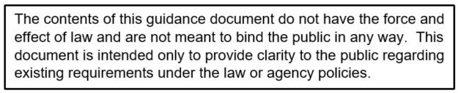
Civil Rights Division
Food and Nutrition Service, USDA

Slide 2



Civil Rights Program and Legal Authorities
Areas of Compliance
  Assurances
  Public Notification Requirements
  Complaints of Discrimination
  Civil Rights Training
  Race and Ethnicity Data Collection
  Limited English Proficiency (LEP)
  Disability Compliance
  Compliance Reviews
  Resolution of Noncompliance
  Conflict Resolution
  Customer Service

Slide 3
Training is required so that individuals involved in all levels of administration of programs that receive Federal financial assistance understand Federal laws, regulations, instructions, policies and other guidance.

Slide 4

Title VI of the Civil Rights of 1964
  Race, Color, and National Origin
Sections 504 of the Rehabilitation Act of 1973, the Americans with Disabilities Act (ADA), & the ADA Amendments Act of 2008
  Disability
Title IX of the Education Amendments of 1972
  Sex
Age Discrimination Act of 1975
  Age

Slide 5
Civil Rights Restoration Act of 1987
- Clarifies the scope of the Civil Rights Act of 1964
7 CFR Part 16, “Equal Opportunity for Religious Organizations”
Executive Order 13166 – “Improving Access to Services for Persons with Limited English Proficiency" (August 11, 2000)
USDA LEP Policy Guidance (79 Fed. Reg. No. 229, page7077. Friday, November 28, 2014)

Slide 6
7 CFR Parts 15, 15a & 15b
7 CFR Part 226 (CACFP)
28 CFR Part 42: Nondiscrimination in Federally- assisted Programs
USDA Departmental Regulation 4330-2
- Prohibits discrimination in programs and activities
receiving Federal financial assistance from USDA.
FNS Instruction 113-1 and Appendix B (CACFP)

Slide 7
Different treatment which makes a distinction of one person or a group of persons from others; either intentionally, by neglect, or
by the actions or lack of actions based on…

Slide 8
For CACFP, different treatment is based on one or more of the six protected bases:
Race
Color
National Origin
Age
Sex
Disability

Slide 9

“To qualify for Federal financial assistance, the program application must be accompanied by a written assurance that the program or facility will be operated in compliance with the Civil Rights laws and implementing
nondiscrimination regulations.”
A Civil Rights assurance statement must be incorporated in all agreements between Federal & State agencies, State & CACFP sponsors, and CACFP sponsors & their sub recipients.
(FNS Instruction 113-1, Appendix B(D)(2)

Slide 10
All FNS programs must include a public notification system.

Slide 11
Program Availability
Inform applicants, participants, and potentially eligible persons of their program rights and responsibilities and the steps necessary for participation.
Complaint Information
Advise applicants and participants at the service delivery point of their right to file a complaint, how to file a complaint, and the complaint procedures.

Slide 12
Nondiscrimination Statement
All information materials and sources, including Web sites, used by FNS, State agencies, local agencies, or other subrecipients to inform the public about FNS programs must contain a nondiscrimination statement.
The statement is not required to be included on every page of the program Web site. At a minimum, the nondiscrimination statement or a link to it must be included on the home page of the program information.

Slide 13
State agencies and/or CACFP sponsors must:
Make program information available to the public upon request;
Prominently display the “And Justice for All” poster;
Inform potentially eligible persons, applicants, participants and
grassroots organizations of programs or changes in programs;
Convey the message of equal opportunity in all photos and other graphics that are used to provide program or program-related information;
Provide appropriate information in alternative formats for persons with disabilities and in the appropriate language(s) for LEP persons.

Slide 14
In accordance with federal civil rights law and U.S. Department of Agriculture (USDA) civil rights regulations and policies, this institution is prohibited from discriminating on the basis of race, color, national origin, sex (including gender identity and sexual orientation), disability, age, or reprisal or retaliation for prior civil rights activity.
Program information may be made available in languages other than English. Persons with disabilities who require alternative means of communication to obtain program information (e.g., Braille, large print, audiotape, American Sign Language), should contact the responsible state or local agency that administers the program or USDA’s TARGET Center at (202) 720-2600 (voice and TTY) or contact USDA through the Federal Relay Service at (800) 877-8339.
To file a program discrimination complaint, a Complainant should complete a Form AD-3027, USDA Program Discrimination Complaint Form which can be obtained online at: https://www.usda.gov/sites/default/files/documents/USDA-OASCR%20P-Complaint-Form-0508-0002-508-11-28-17Fax2Mail.pdf, from any USDA office, by calling (866) 632-9992, or by writing a letter addressed to USDA. The letter must contain the complainant’s name, address, telephone number, and a written description of the alleged discriminatory action in sufficient detail to inform the Assistant Secretary for Civil Rights (ASCR) about the nature and date of an alleged civil rights violation. The completed AD-3027 form or letter must be submitted to USDA by:
mail:
U.S. Department of Agriculture
Office of the Assistant Secretary for Civil Rights
1400 Independence Avenue, SW
Washington, D.C. 20250-9410; or
fax:
(833) 256-1665 or (202) 690-7442; or
email:
program.intake@usda.gov

Slide 15
De conformidad con la Ley Federal de Derechos Civiles y los reglamentos y políticas de derechos civiles del Departamento de Agricultura de los EE. UU. (USDA, por sus siglas en inglés), se prohíbe que el USDA, sus agencias, oficinas, empleados e instituciones que participan o administran programas del USDA discriminen sobre la base de raza, color, nacionalidad, sexo, discapacidad, edad, o en represalia o venganza por actividades previas de derechos civiles en algún programa o actividad realizados o financiados por el USDA.
Las personas con discapacidades que necesiten medios alternativos para la comunicación de la información del programa (por ejemplo, sistema Braille, letras grandes, cintas de audio, lenguaje de señas americano, etc.), deben ponerse en contacto con la agencia (estatal o local) en la que solicitaron los beneficios. Las personas sordas, con dificultades de audición o discapacidades del habla pueden comunicarse con el USDA por medio del Federal Relay Service [Servicio Federal de Retransmisión] al (800) 877-8339. Además, la información del programa se puede proporcionar en otros idiomas.
Para presentar una denuncia de discriminación, complete el Formulario de Denuncia de Discriminación del Programa del USDA, (AD-3027) que está disponible en línea en: http://www.ascr.usda.gov/complaint_filing_cust.html y en cualquier oficina del USDA, o bien escriba una carta dirigida al USDA e incluya en la carta toda la información solicitada en el formulario. Para solicitar una copia del formulario de denuncia, llame al (866) 632-9992. Haga llegar su formulario lleno o carta al USDA por:
(1) correo: U.S. Department of Agriculture
Office of the Assistant Secretary for Civil Rights 1400 Independence Avenue, SW
Washington, D.C. 20250-9410;
(2) fax: (202) 690-7442; o
(3) correo electrónico: program.intake@usda.gov.
Esta institución es un proveedor que ofrece igualdad de oportunidades.

Slide 16
USDA Nondiscrimination Statement (NDS)
  Short version
    This institution is an equal opportunity provider.
    Esta institución es un proveedor que ofrece igualdad de oportunidades. (Spanish)
    *Can be used in special circumstances only
  Translations
    Other languages are forthcoming

Slide 17
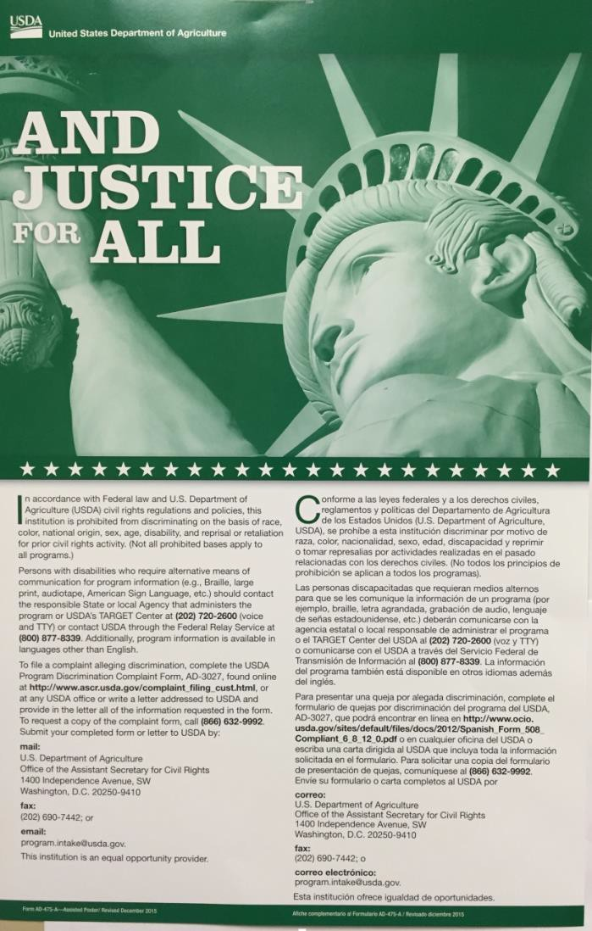
Display the poster in a prominent location for all to view
  AD-475A
    New required version for CACFP

Slide 18
Complaints shall be accepted and forwarded to USDA;
Complaints must be filed within 180 days from the
alleged act of discrimination;
Complaints may be written, verbal, or anonymous;
State agencies or subrecipient agencies may develop their own complaint forms, but the use of such forms cannot be a pre-requisite for acceptance ;
A separate Civil Rights complaint log shall be
maintained by the State & subrecipient agency;
Confidentiality is extremely important and must be maintained.

Slide 19
Complaints should include:
Name, address, and telephone number of the complainant
The location and name of the organization or office
The nature of the incident or action
The names, titles, and business addresses of persons who may have knowledge of the discriminatory action
The date(s) during which the alleged discriminatory actions occurred
The basis for the alleged discrimination.

Slide 20
USDA Discrimination Complaint Form
  English
http://www.ocio.usda.gov/sites/default/files/docs/2012/Co
mplain_combined_6_8_12.pdf
  Spanish
http://www.ocio.usda.gov/sites/default/files/docs/2012/Sp
anish_Form_508_Compliant_6_8_12_0.pdf

Slide 21

State agencies are responsible for training CACFP sponsors on an annual basis;
CACFP sponsors are responsible for training their sub recipients, including “frontline
staff” who interact with applicants or
participants on an annual basis;
New employees before participating in Program activities;
Volunteers must receive training.

Slide 22

All staff should receive training on all aspects of Civil Rights compliance, including:
Collection and use of data;
Effective public notification systems;
Complaint procedures;
Compliance review techniques;
Resolution of noncompliance;
Requirements for reasonable accommodation of persons with disabilities;
Requirements for language assistance;
Conflict resolution; and
Customer service.

Slide 23
As a means of monitoring civil rights
compliance, State agencies shall establish a
system for the collection of racial/ethnic data
of each person applying for and receiving
benefits.
Applicants shall be assured that the
information is required for and used for
statistical purposes only and has no effect on
eligibility criteria.
Data should be collected at the point of
application and retained at the service delivery
area.

Slide 24
1. Ethnicity (must select one of the following)
Two Question Format
Hispanic or Latino
Not Hispanic or Latino
Race (one or more of the following)
  American Indian or Alaskan Native
  Asian
  Black or African American
  Native Hawaiian or Other Pacific Islander
  White

Slide 25

Title VI and its implementing regulations, Executive Order 13166, and Federal agency Guidance require Federal agencies and recipients (State agencies, local agencies, or other subrecipients), to take reasonable
steps to ensure “meaningful” access to their programs and activities by Limited English Proficient (LEP) persons.
(FNS Instruction 113-1, Section VII)

Slide 26

Individuals who do not speak English as their primary language and who have a limited ability to read, speak, write, or understand English.

Slide 27
Meaningful access is accomplished by providing reasonable, timely, appropriate, competent/qualified, accurate, and effective language services to individuals with LEP when accessing recipient programs and activities.

Slide 28

Factors to consider in addressing LEP:
Number or proportion of LEP persons served or encountered in the eligible population.
Frequency with which LEP individuals come in contact with the program.
Nature and importance of the program, activity, or service provided by the program.
Resources available to the recipient and costs.

Slide 29

Population data sources
Interagency LEP Website – Mapping Tool
  http://www.lep.gov/maps/
US Census Data
  http://www.census.gov/2010census/data/
American Community Survey
  http://www.census.gov/acs/
Migration Policy Institute’s National Center on Immigrant
Integration Policy
http://www.migrationpolicy.org/

Slide 30
Sections 504 of the Rehabilitation Act of 1973 and USDA implementing Regulation, 7 CFR Part 15b
  prohibits discrimination based on disability in programs or activities receiving Federal financial assistance.
Americans with Disabilities Act (ADA), 28 CFR Part 35, Title II, Subtitle A
  prohibits discrimination on the basis of disability in all services, programs and activities provided to the public by State and local governments.
These Civil Rights laws protect persons with disabilities if they are potential applicants or participants in any FNS funded programs.

Slide 31
What is the definition of disability?
A person who has a physical or mental impairment which substantially limits one or more major life activities, has a record of such an impairment, or is regarded as having such an impairment.
Major life activity means functions such as caring for one’s self, performing manual tasks, walking, seeing, hearing, speaking, breathing, learning and working.
Functions of the immune system, normal cell growth, digestive, bowel, bladder, neurological, brain, respiratory, circulatory, cardiovascular, endocrine, and reproductive functions.
(ADA Amendments Act of 2008)

Slide 32
The ADA requires public entities to make “reasonable modifications” in their usual ways of doing things when necessary to
accommodate people who have disabilities. (e.g. provide Braille, large print, audio tape, other auxiliary aids or services).
Providing qualified sign language interpreters for persons with hearing disabilities may be necessary to effectively communicate with these applicants and participants.

Slide 33

7 CFR Part 16 notes:
Ensures a level playing field for the participation of faith-based organizations and other community organizations in USDA programs.

Slide 34

Examine the activities of State agencies, CACFP sponsors, and sub recipients to determine Civil Rights compliance;
FNS Civil Rights and Program staff review State agencies.
- FNS staff and State agencies review CACFP sponsors. CACFP sponsors review their sub recipients.
Significant findings must be provided in writing to the reviewed entity and to FNS.

Slide 35

There are three types of compliance reviews:
Pre-Award Compliance Reviews
Routine (Post-Award) Compliance Reviews
Special Compliance Reviews

Slide 36

State agencies, CACFP sponsors, or other sub recipients must be in compliance with Civil Rights requirements prior to approval for Federal financial assistance.

Slide 37

Areas of review
Assurances
Public Notification
Racial and Ethnic Data Collection and Reporting
Civil Rights Complaints
Compliance Reviews
Resolution of Noncompliance
Civil Rights Training
Disability Compliance
Limited English Proficiency

Slide 38
May be scheduled or unscheduled;
To follow-up on previous findings of noncompliance;
To investigate reports of noncompliance by other agencies, media, or grassroots organizations;
May be specific to an incident or policy;
History of statistical underrepresentation of particular group(s);
Pattern of complaints of discrimination.

Slide 39
A factual finding that any civil rights requirement, as provided by law, regulation, policy, instruction, or guidelines, is not being adhered to by a State agency, local agency, or other sub recipient.
Steps must be taken immediately to obtain
voluntary compliance.
A finding’s effective date is the date of notice to the reviewed entity.

Slide 40
A Voluntary Resolution Agreement (VRA) is an agreement that recipient(s) are willfully consenting to undertake remedial actions to address identified areas of noncompliance or in violation with applicable civil rights laws and/or regulations.
The VRA may be between multiple parties such as the officials in authority to regulate civil rights laws (Food and Nutrition Service, Civil Rights Division, (FNS CRD)), recipient or sub-recipient (State agency or school), and program participant (Complainant).

Slide 41
Voluntary Resolution Agreements may be used to closeout a Civil Rights Compliance Review at the discretion of FNS CRD in lieu of issuing a written Compliance Review report with findings.

Slide 42
Questions?

Slide 43
Name Title
Address Line 1
Address Line 2
Address Line 3 City, State Zip Code
Telephone:
Email:

